Slide 1


Slide 2

Expert-level Windows 10 deployment
Johan Arwidmark, TrueSec
CTO @jarwidmark johan.arwidmark@truesec.com
Mikael Nystrom, TrueSec
Principal Architect
@mikael_nystrom mikael.nystrom@truesec.se

Slide 3

Tweet, Tweet, Tweet

Slide 4

Agenda
ConfigMgr
MDT
Notes:
We have purchased this stock photo image, please don’t remove

Slide 5

Demo environment
Available for download
DC01
MDT01
CM01
PCxxxx
Notes:
We have purchased this stock photo image, please don’t remove

Slide 6

DEMO

Slide 7
Creating reference images
MDT 8456 Lite Touch
Automate everything (a.k.a Image Factory)
Offline Servicing

Slide 8
DEMO

Slide 9
Supporting Windows 10 OSD
MDT 8456
ConfigMgr Current Branch

Slide 10
DEMO

Slide 11
OSD Automation, Part 1
New cmdlets for OSD Automation
Building workflows and repetitive tasks
PowerShell in Task Sequences

Slide 12
DEMO

Slide 13
OSD Automation, Part 2
BIOS Updates
BIOS to UEFI Conversions
Driver Handling

Slide 14
DEMO

Slide 15
Sneak Preview…
PowerShell Deployment Kit (PSD)

Slide 16
DEMO

Slide 17
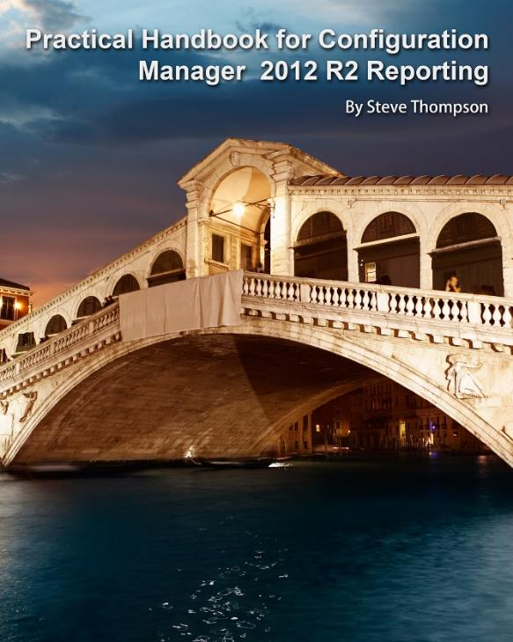
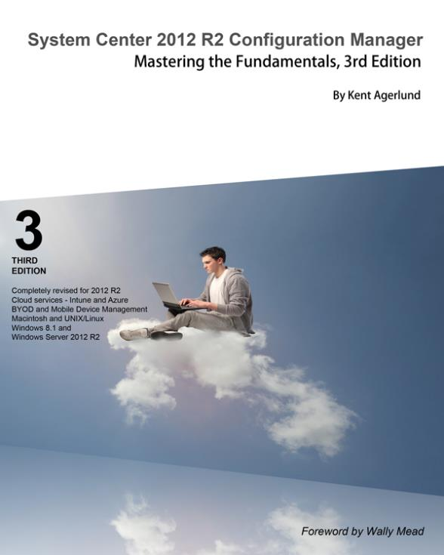
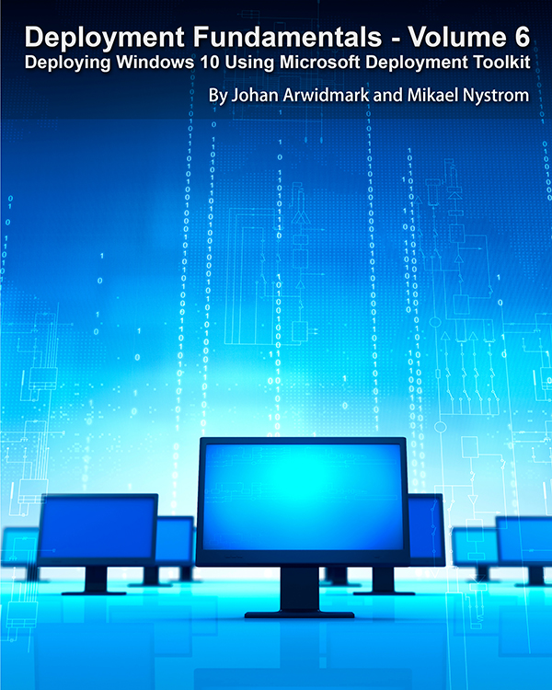
Resources: Trainings - Videos - Books
https://deploymentartist.com

Slide 18
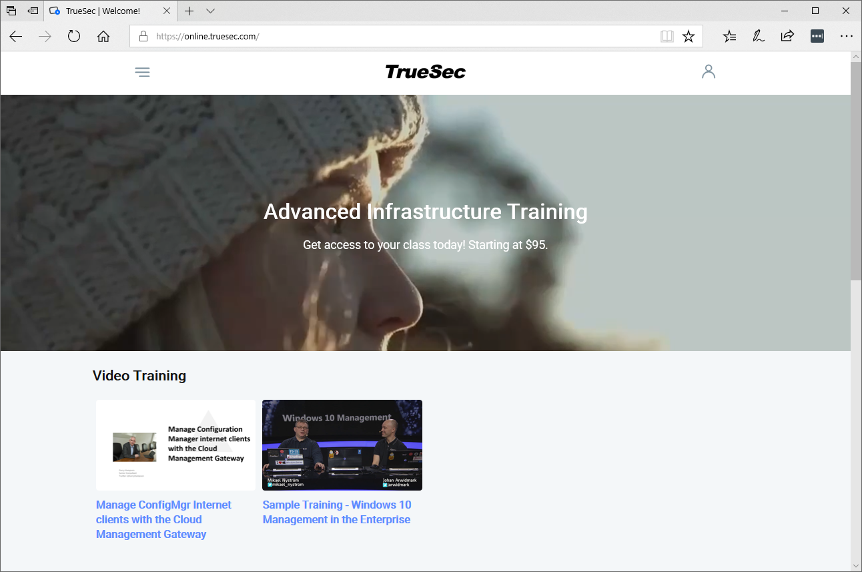
https://online.truesec.com

Slide 19

Slides and demos from the conference will be available at
https://github.com/nordicinfrastructureconference/2019

Slide 20


